Slide 1
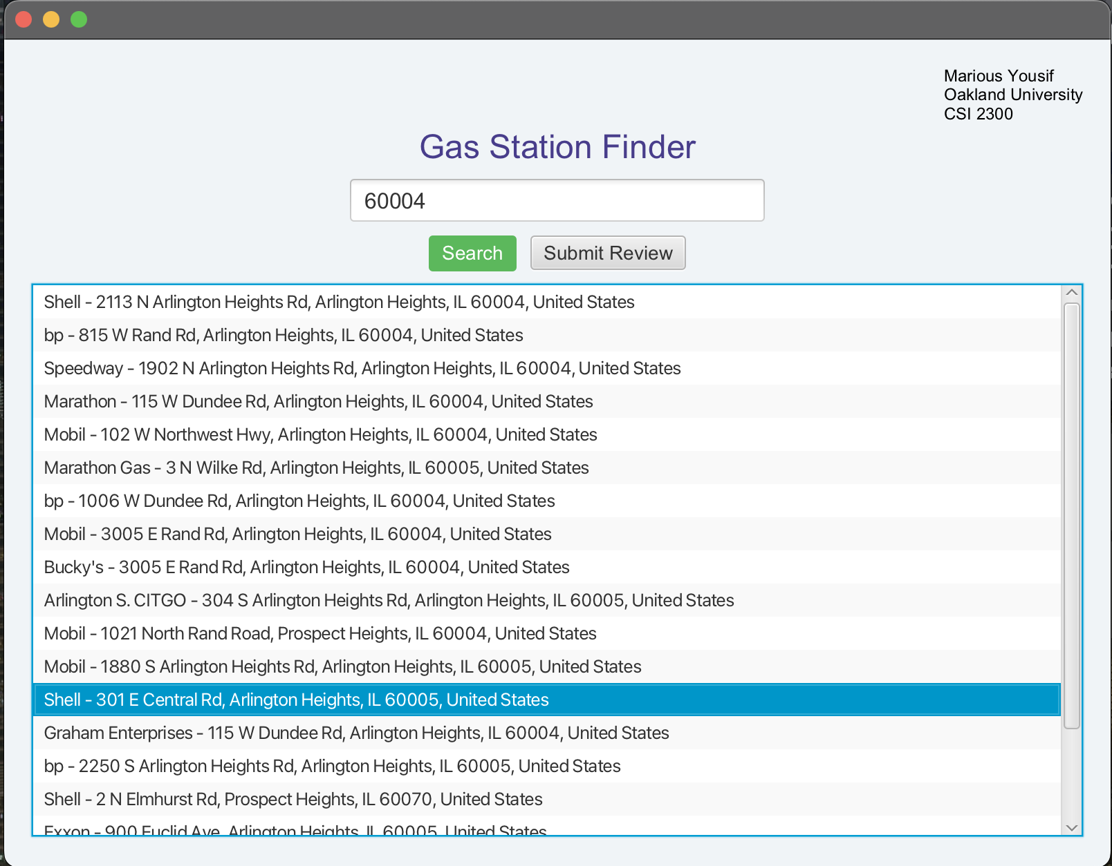
Gas Station Finder
An Interactive JavaFX Application
Marious Yousif
CSI 2300

Slide 2
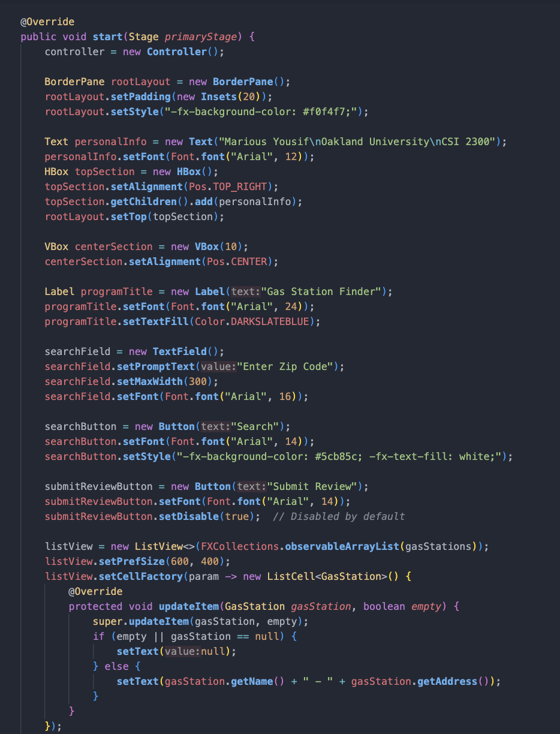
Introduction
Gas Station Finder simplifies the search for nearby gas stations by using zip codes
With many options available, finding the most convenient gas station can be time consuming
This program consolidates locations into a single, user-friendly interface
Allows users to review and view others reviews for each location

Slide 3
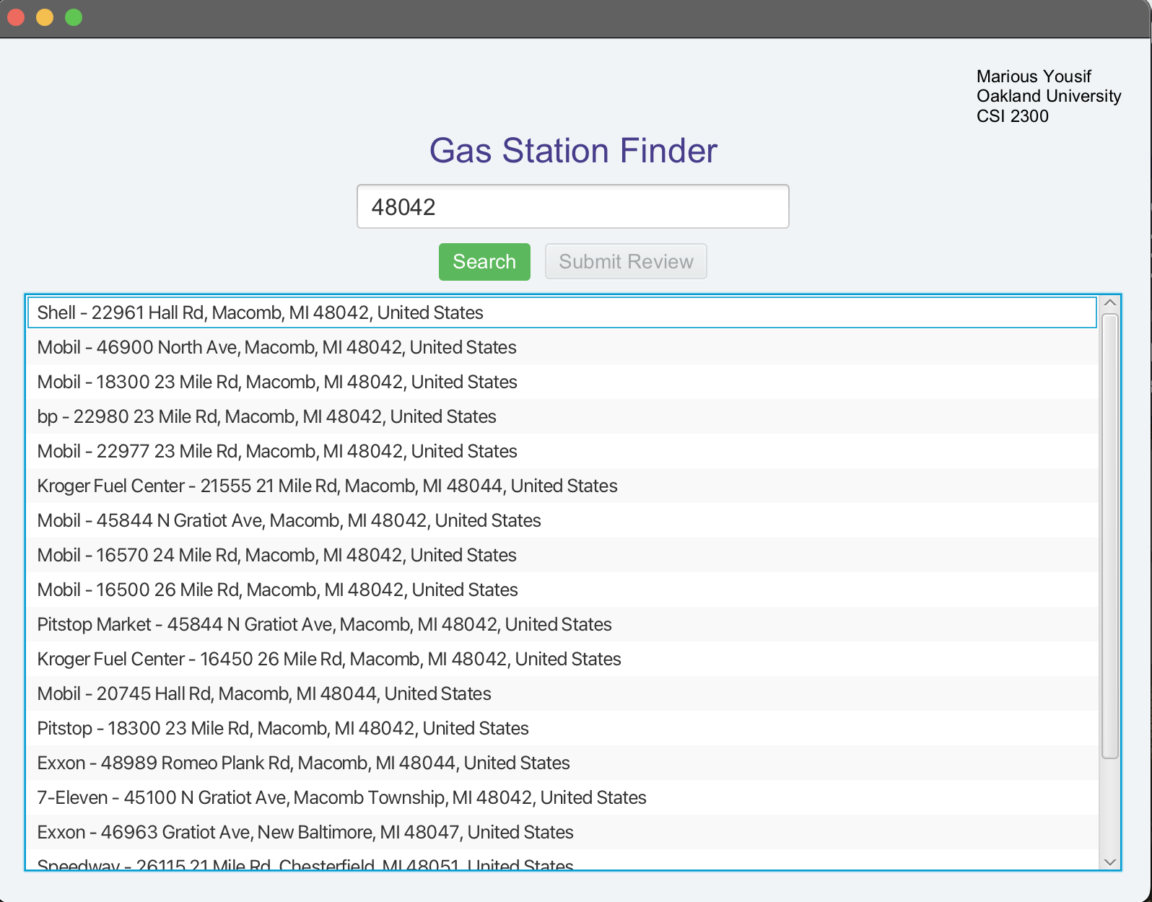
Application Overview
Search for gas stations by zip code
Displays each location within the given zip code in a list
Allows users to submit and view reviews for each gas station

Slide 4
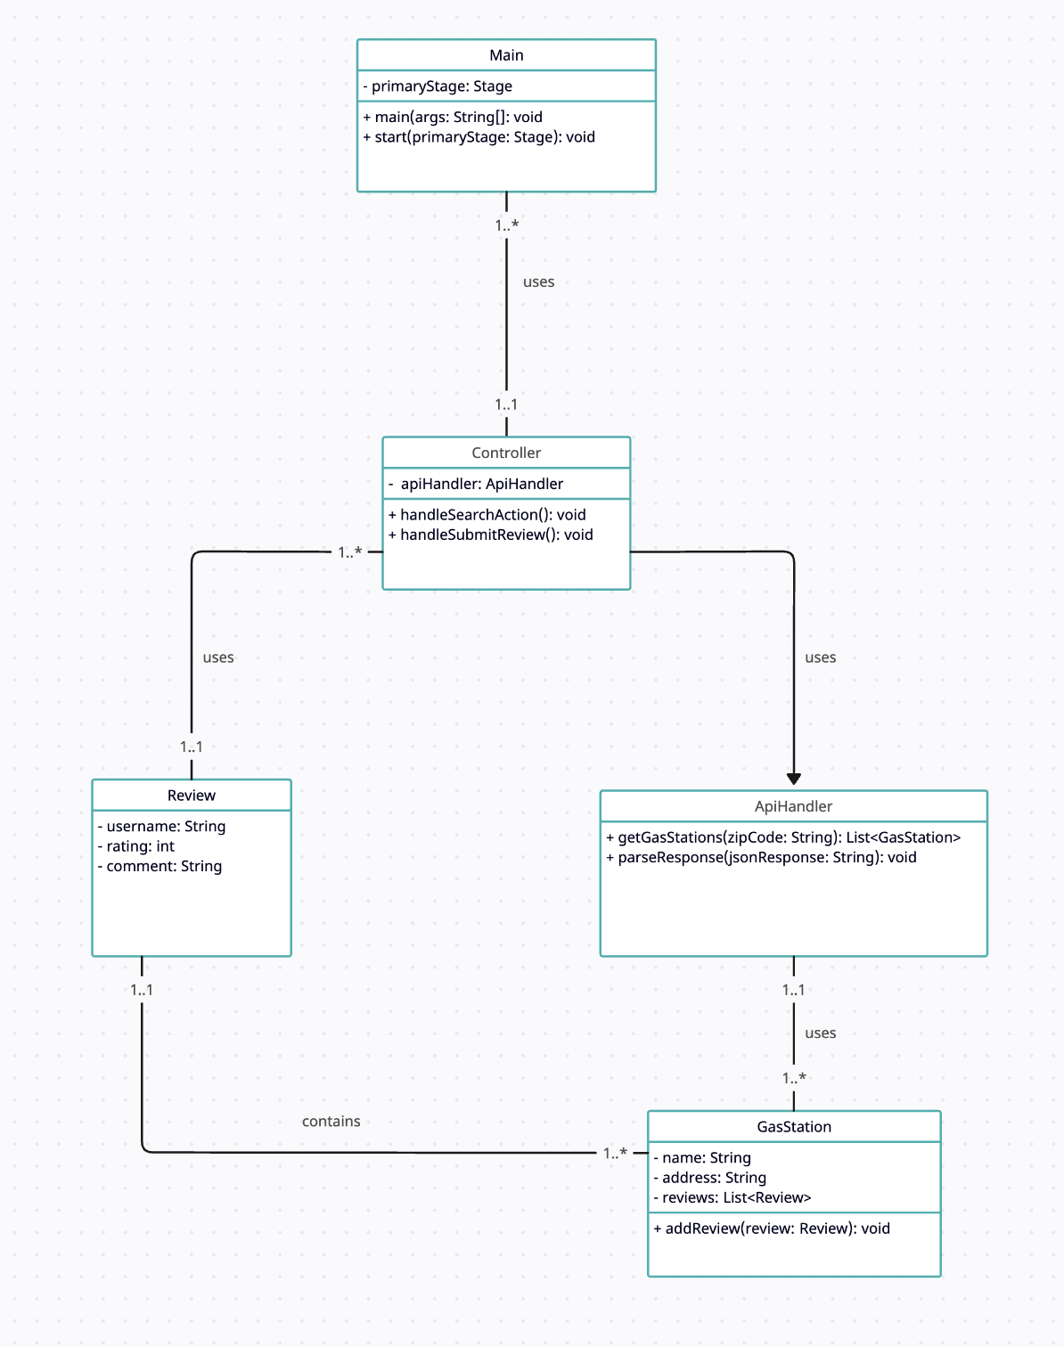
UML Class Diagram
Main - Sets up the program’s primary stage and scene
Controller – Manages the user interactions (search box) and updates the view
ApiHandler – Handles the retrieval of gas station data from the Google Places API
GasStation – Represents a gas station and its associated data
Review – Represents a review submitted by a user

Slide 5
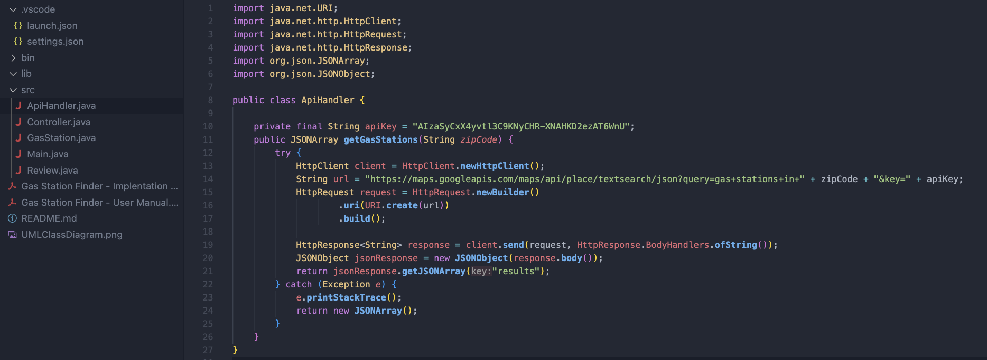
Key Learnings/Challenges
More experience using JavaFX, this time for an application that solves a real-world problem
Learned how to setup and integrate an API into the Java program, which was the most difficult part of this project
Figuring out a design that would be easy and simple to use for the user

Slide 6
Future Enhancements
Adding an interactive map to view each gas station
Integrating a database to store user reviews, such as SQL
Creating a login system so users can create profiles and keep track of reviews

Slide 7
Demo Video
Gas Station Demo Vid

